Slide 1
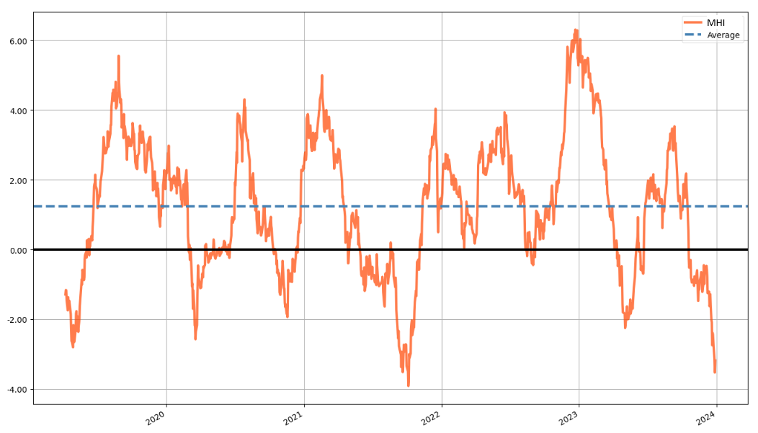
Market Health Index (MHI) - A mean-reverting index for trend detection
Peaks:
11.09.2023
27.12.2022
7.06.2022
Valleys:
26.12.2023
9.05.2023
16.08.2023
(Last 1835 days)

Slide 2
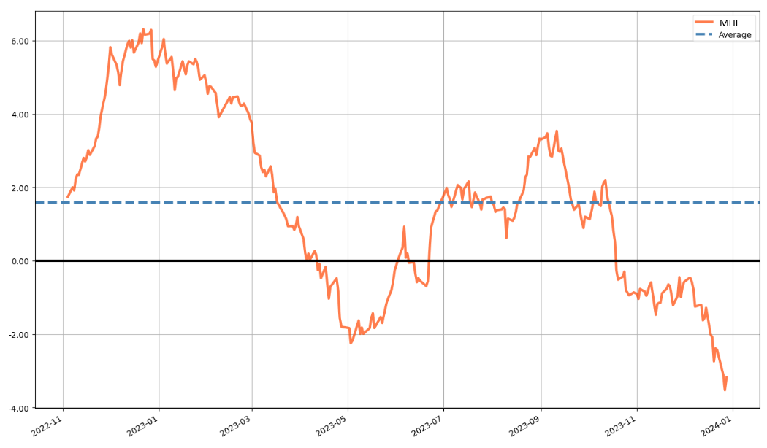
MHI - Last 365 days

Slide 3
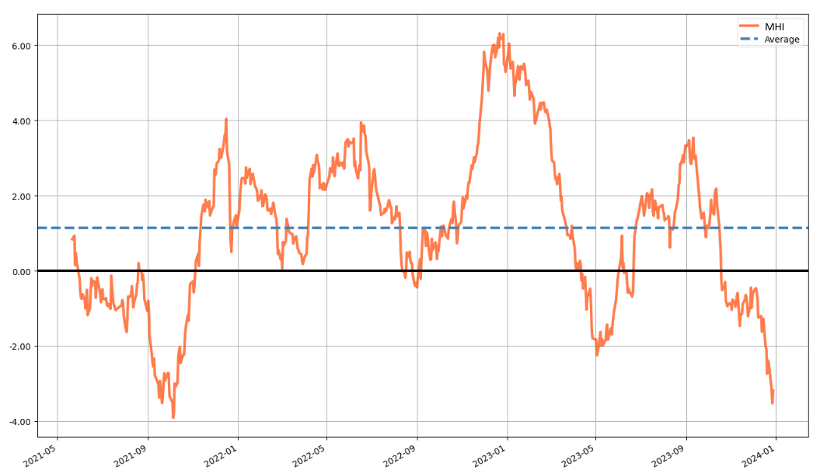
MHI - Last 730 days

Slide 4
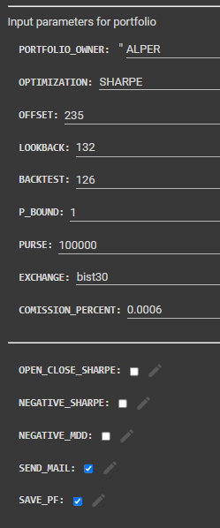
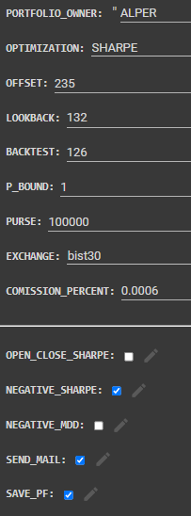
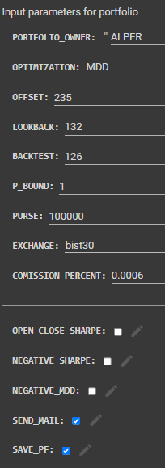
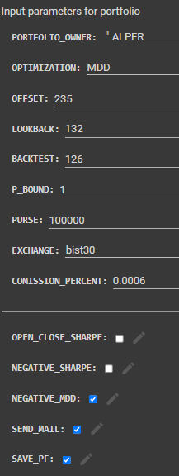
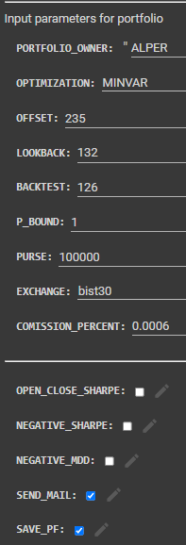

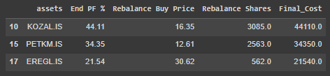
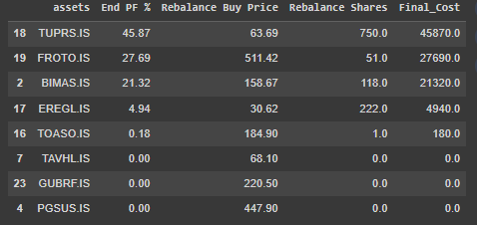

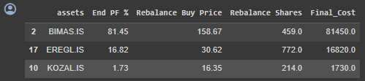
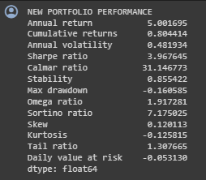
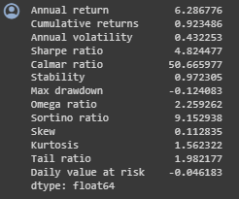
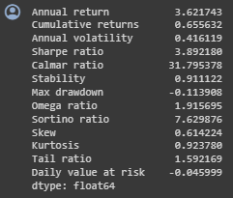
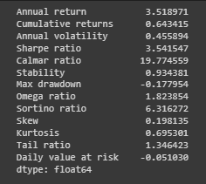
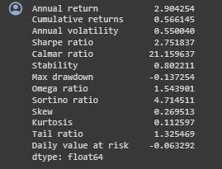
Sharpe, Inverse Sharpe, MDD, Inverse MDD and MINVAR Portfolios
Return: %56.6
SR: 2.75
MDD: %13.7
Return: %80.4
SR: 3.96
MDD: %16.1
Return: %92.3
SR: 4.82
MDD: %12.4
Return: %65.6
SR: 3.39
MDD: %11.4
Return: %64.3
SR: 3.96
MDD: %17.8

